Slide 1
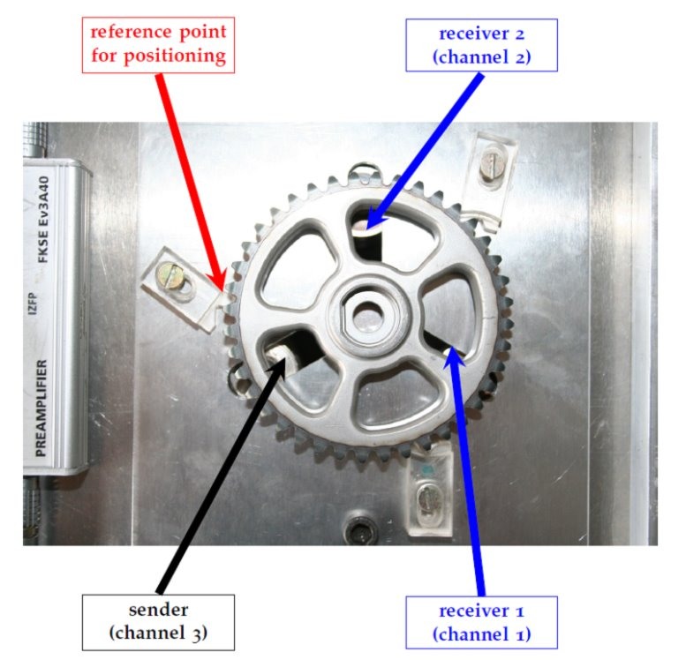
Exploratory analysis of NDT data from gears
Date: 19th June 2025
Subject: Artificial Intelligence in Material Diagnostics
Lecturers: Prof. Dr.-Ing. Constanze Tschöpe, Dr. Ivan Kraljevski
Group Members: Talib Gasanov, Dmitriy Kozyrev, Eric Sprunk, Volodymyr Telesh

Slide 2
Outline
Introduction and task
Data set and loading of data
Feature analysis of the signals
Principal Component Analysis (PCA) for dimensionality reduction
Visualization and evaluation

Slide 3
Introduction and task
Explorative analysis is crusial for finding pattern and trends in data and also for detecting outliers.
Non-destructive testing is important to keep gears (or other materials) intact.
Task:
Load the given signals into a data frame
Apply principle component analysis (PCA) to reduce the dimensionality of the features
Visualize the data points in 2-dimensional diagrams
Evaluate the results

Slide 4
2. Data
Data set: 5 gears (Z01–Z05)
110 position files (Z01: 50, Z04: 30, others: 10 each)
Each position file: 2 channels with 2 variants each
In total: 440 data files

Slide 5
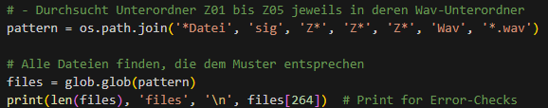
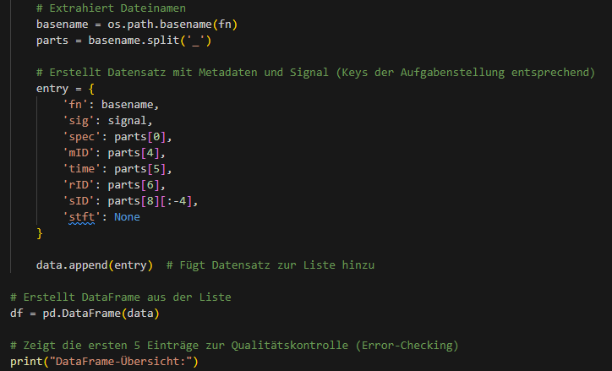
2. Data
We use os.path.join for reading the data
We get all the data with .wav at the end
In 'entry' we put the keys, according
to the task
After that we add it to our data list

Slide 6
3. Feature analysis of the signals
We extract the following features:
Magnitude Mean: Magnitude by averaged time
Spectral mean: average frequency, weightened by magnitude
Spectral variance: distance of each frequency bin from the mean
Upper entropy: describes how irregular the upper spectrum part is
Flatness: used for finding out how much noise there is
Rolloff frequency: 85% of energy is below this frequency
Upper kurtosis: reflects spikyness or asymmetry in the upper hand

Slide 7
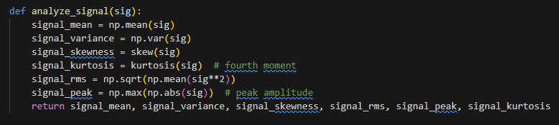

3. Feature analysis of the signals
More signal features:
The feature list:

Slide 8
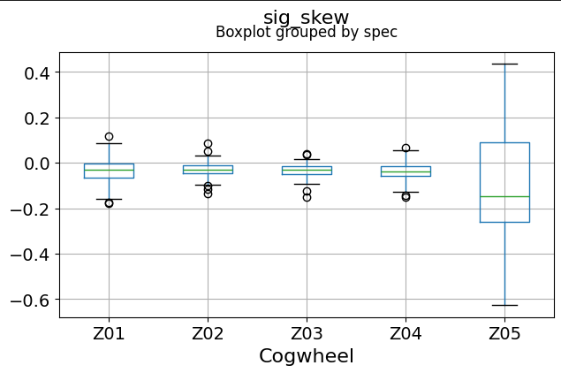
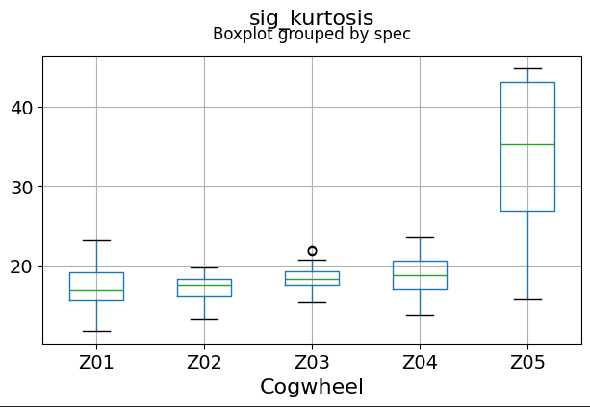
3. Feature analysis of the signals
Boxplots for skew and kurtosis:

Slide 9
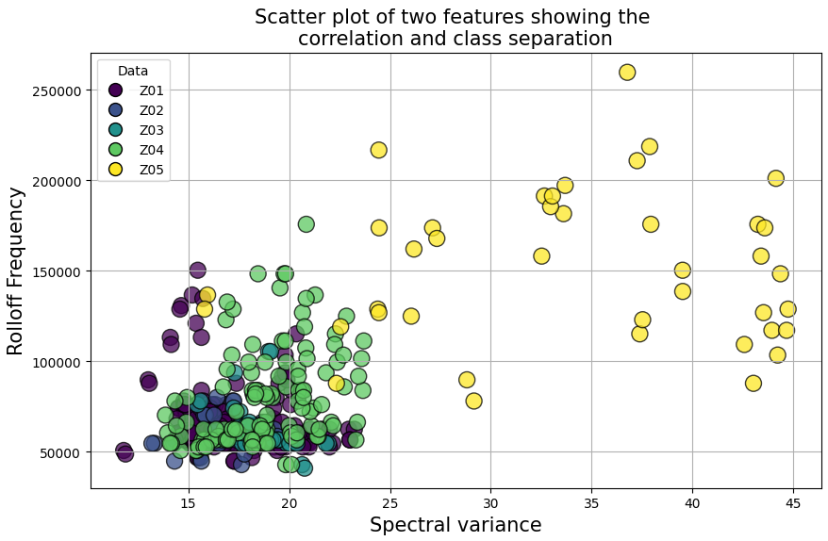
3. Feature analysis of the signals

Slide 10
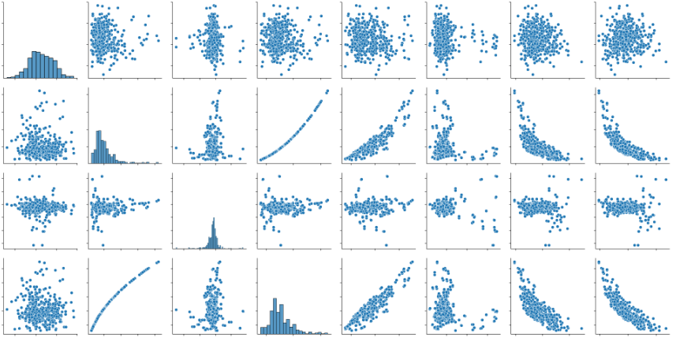
3. Feature analysis of the signals
Feature Overview using Seaborn:

Slide 11

4. Principal Component Analysis
Goal of PCA: Reduce the number of variables by using new uncorrelated components that explain as much variance in the original data as possible.
PCA calculates linear combinations of the original variables, where the first principal component captures the greatest variance
The explained variance ratio shows how much of the total variance is explained by each principal component

Slide 12
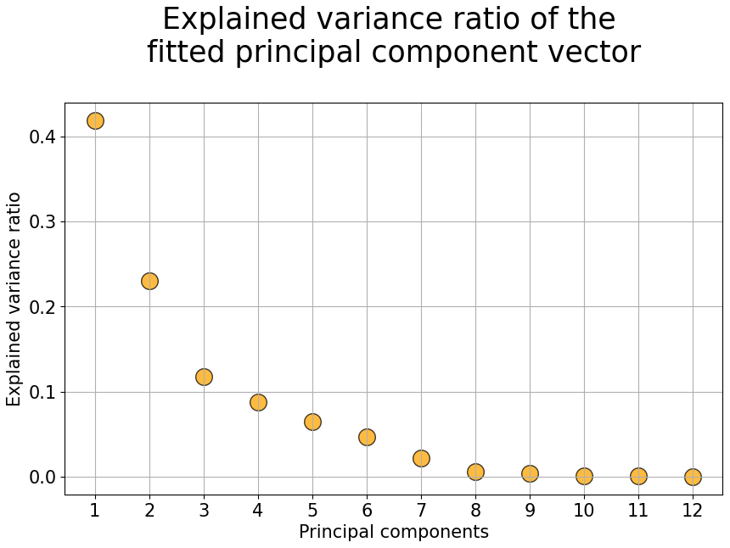
4. Principle Component Analysis

Slide 13
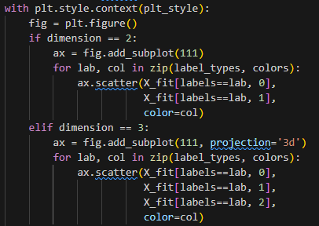
4. Dimensionality Reduction
Goal of dimensionality reduction: Reduce the number of variables in a data set without losing important information.
We plot 2D and 3D scatter plots
Reduce dimensionality:

Slide 14
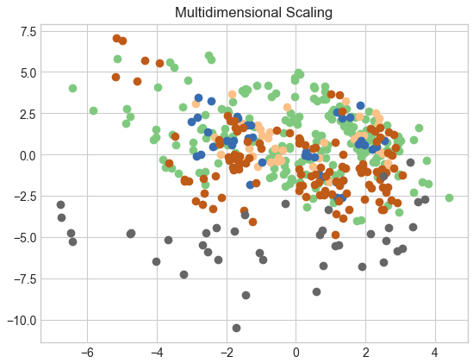
5. Visualization of data points

Slide 15
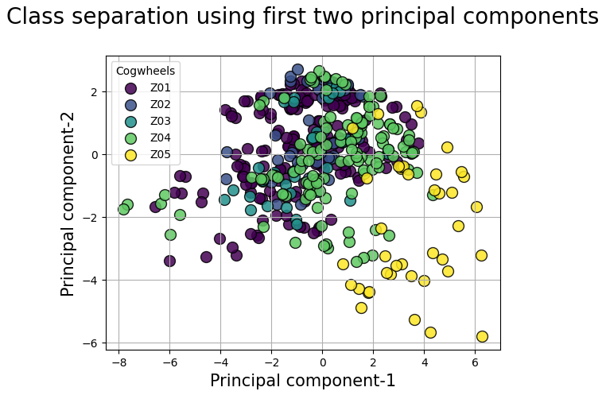
5. Visualization of data points

Slide 16
5. evaluation
We see that the data points appear around (0,0) in the diagram
Z01 – Z04 appear similar to each other, because most of their data points are close to (0,0)
Z05 is offset compared to Z01 - Z04

Slide 17
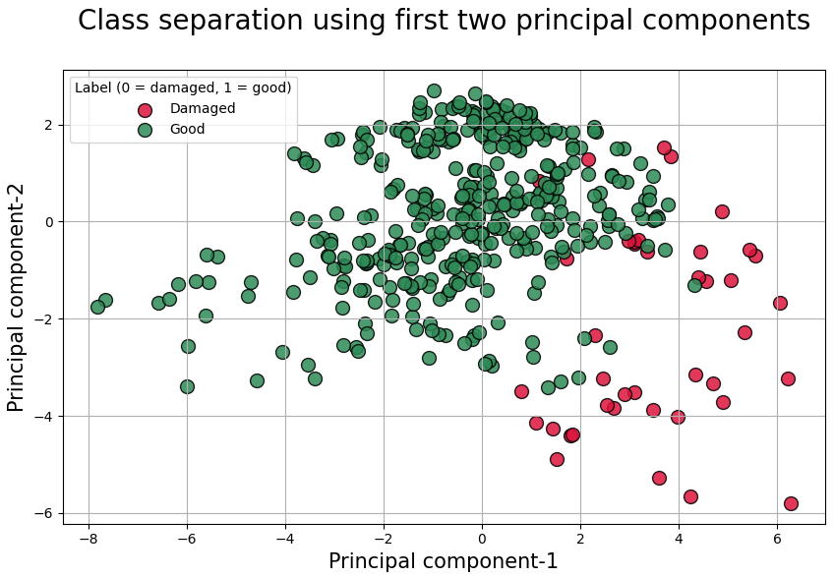
5. evaluation
As a result we create a class separation diagram:

Slide 18
5. evaluation
We see that data points of Z01 – Z04 appear good
Whereas data points of Z05 appear damaged
We conclude:
Z05 is a damaged gear, while all others are in good condition
But no gear is perfect! If one were, all of its data points would be at (0,0)

Slide 19
Thank you for your attention

